Slide 1


Methods
Chris Piech
CS106A, Stanford University
This is Method Man. He is part of the Wu Tang Clan. ☺

Slide 2
Civilization advances by extending the number of operations we can perform without thinking about them.
-Alfred North Whitehead

Slide 3

Learn How To:
Write a method that takes in input
Write a method that gives back output
Trace method calls using stacks

Slide 4
Calling Methods
turnRight();
move();
readInt(“Int please! ”);
println(“hello world”);
rect.setFilled(true);
drawRobotFace();
add(rect);
preventGlobalWarming();

Slide 5

Defining a Method
private void turnRight() {
turnLeft();
turnLeft();
turnLeft();
}
Big difference with Java methods:
Java methods can take in data, and can return data!

Slide 6
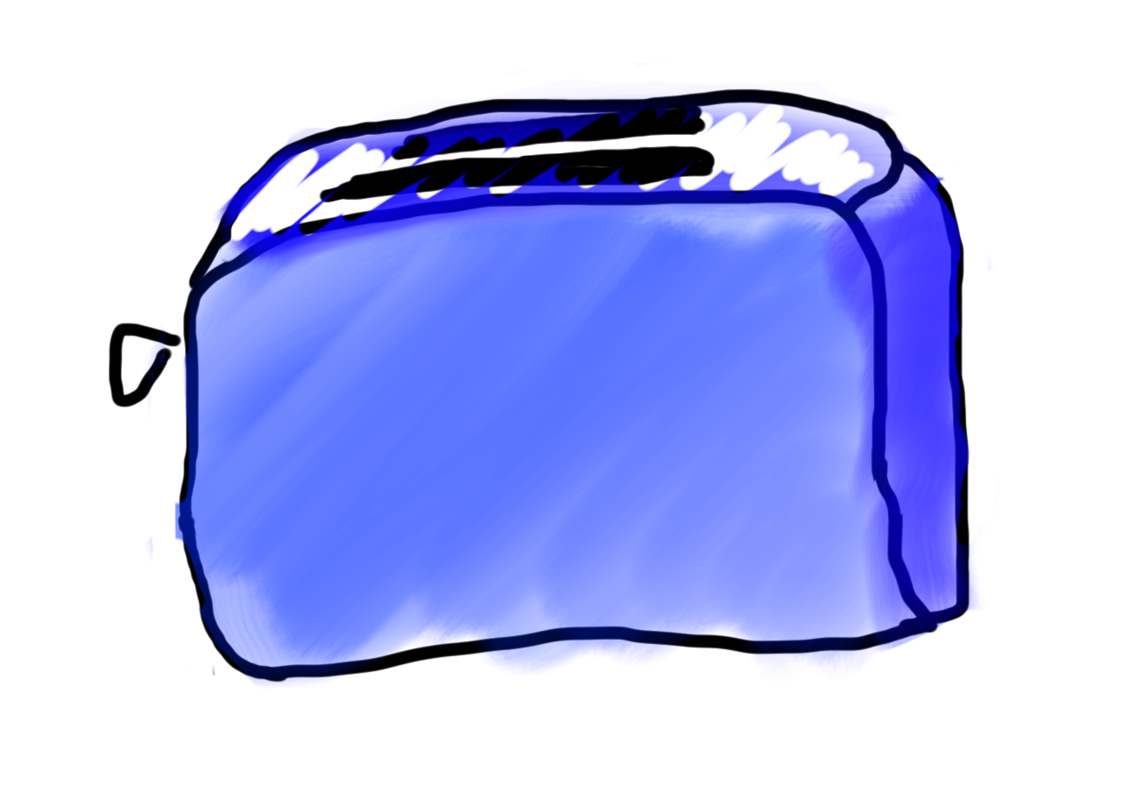
Toasters are Methods
For example:
runToaster
- Thanks Mehran

Slide 7
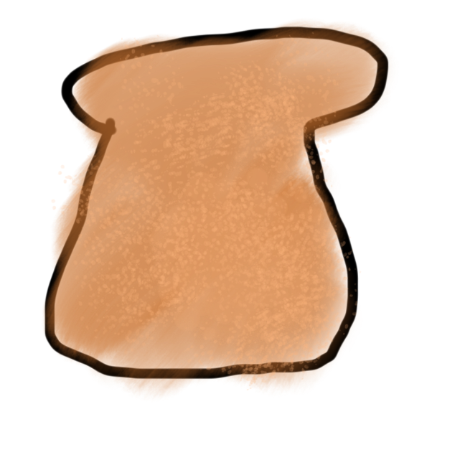
Toasters are Methods
parameter

Slide 8

Toasters are Methods
parameter

Slide 9
Toasters are Methods

Slide 10

Toasters are Methods

Slide 11
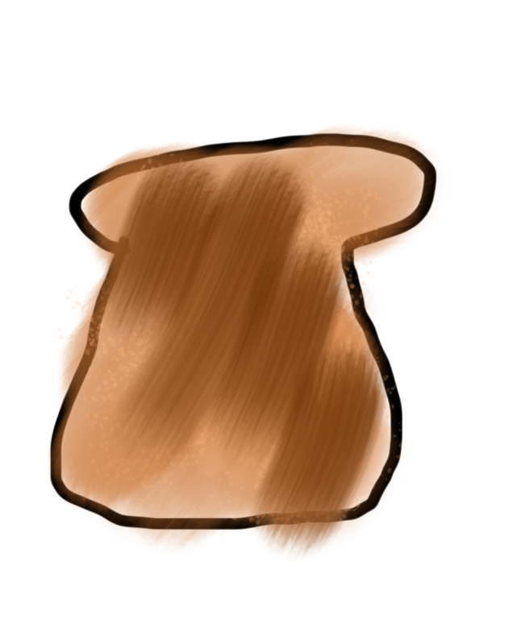
Toasters are Methods
return

Slide 12
Toasters are Methods

Slide 13
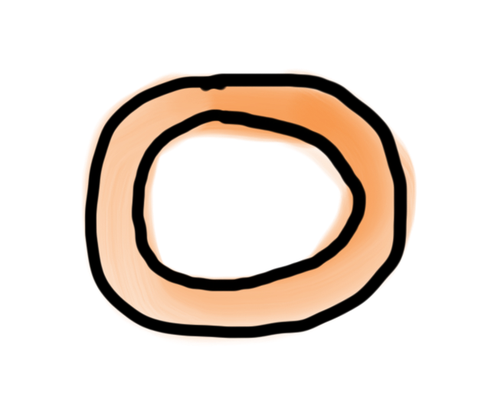
Toasters are Methods
* You don’t need a second toaster if you want to toast bagels. Use the same one.

Slide 14
Toasters are Methods

Slide 15

Toasters are Methods

Slide 16
Toasters are Methods

Slide 17
Toasters are Methods

Slide 18
Toasters are Methods

Slide 19
Methods are Like Toasters

Slide 20
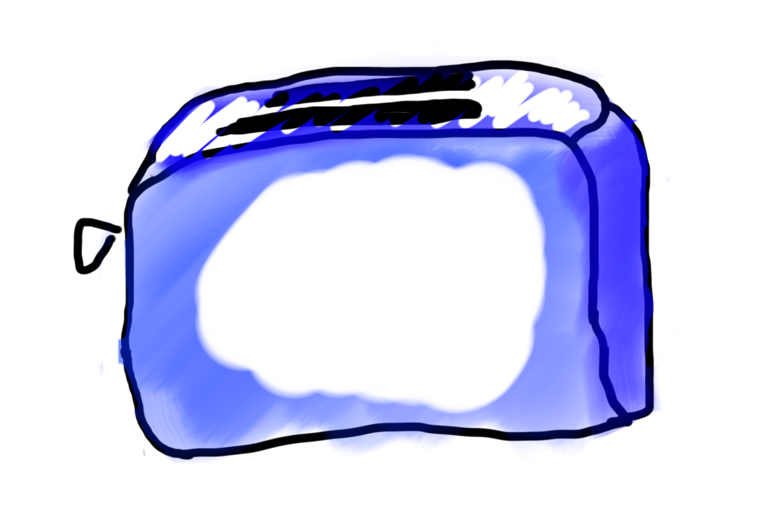
Methods are Like Toasters

Slide 21
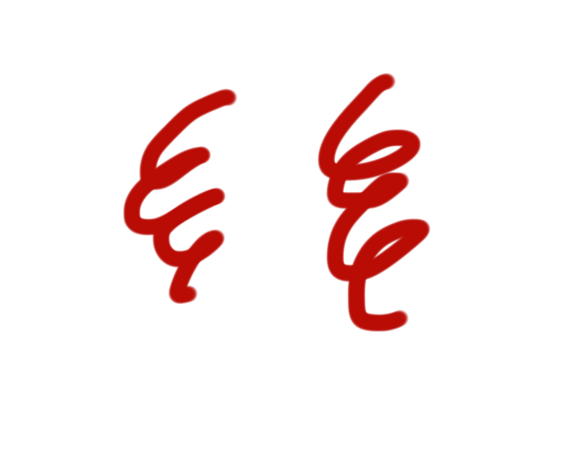
Methods are Like Toasters

Slide 22

Methods are Like Toasters

Slide 23
Methods are Like Toasters
parameter(s)
return

Slide 24
Formally
visibility type nameOfMethod(parameters) {
statements
}
visibility: usually private or public
type: type returned by method (e.g., int , double, etc.)
Can be void to indicate that nothing is returned
parameters: information passed into method

Slide 25
Anatomy of a method
public void run() {
double mid = average(5.0, 10.2);
println(mid);
}
private double average(double a, double b) {
double sum = a + b;
return sum / 2;
}

Slide 26
Anatomy of a method
public void run() {
double mid = average(5.0, 10.2);
println(mid);
}
private double average(double a, double b) {
double sum = a + b;
return sum / 2;
}
method “definition”

Slide 27
Anatomy of a method
public void run() {
double mid = average(5.0, 10.2);
println(mid);
}
private double average(double a, double b) {
double sum = a + b;
return sum / 2;
}
Output expected
Input expected

Slide 28
Anatomy of a method
public void run() {
double mid = average(5.0, 10.2);
println(mid);
}
private double average(double a, double b) {
double sum = a + b;
return sum / 2;
}
Return Type
Parameters

Slide 29
Anatomy of a method
public void run() {
double mid = average(5.0, 10.2);
println(mid);
}
private double average(double a, double b) {
double sum = a + b;
return sum / 2;
}
name

Slide 30
Anatomy of a method
public void run() {
double mid = average(5.0, 10.2);
println(mid);
}
private double average(double a, double b) {
double sum = a + b;
return sum / 2;
}
body

Slide 31
Anatomy of a method
public void run() {
double mid = average(5.0, 10.2);
println(mid);
}
private double average(double a, double b) {
double sum = a + b;
return sum / 2;
}
Ends the method and gives
back a single value

Slide 32
Anatomy of a method
public void run() {
double mid = average(5.0, 10.2);
println(mid);
}
private double average(double a, double b) {
double sum = a + b;
return sum / 2;
}
This statement is necessary because average promised to return a double

Slide 33
Anatomy of a method
public void run() {
double mid = average(5.0, 10.2);
println(mid);
}
private double average(double a, double b) {
double sum = a + b;
return sum / 2;
}
method “call”

Slide 34
Anatomy of a method
Return Type
Parameters
public void run() {
double mid = average(5.0, 10.2);
println(mid);
}
private double average(double a, double b) {
double sum = a + b;
return sum / 2;
}

Slide 35
Anatomy of a method
public void run() {
double mid = average(5.0, 10.2);
println(mid);
}
private double average(double a, double b) {
double sum = a + b;
return sum / 2;
}
When a method ends it “returns”

Slide 36

Parameters
Parameters let you provide a method some information when you are calling it.

Slide 37

Learn by Example

Slide 38
Void Example
private void printIntro() {
println("Welcome to class");
println("It's the best part of my day.");
}
public void run() {
printIntro();
}

Slide 39
Parameter and Return Example
private double metersToCm(double meters) {
return 100 * meters;
}
public void run() {
double result = metersToCm(5.2);
println(result);
}

Slide 40
Parameter and Return Example
private double metersToCm(double meters) {
return 100 * meters;
}
public void run() {
println(metersToCm(5.2));
println(metersToCm(9.1));
}

Slide 41
Parameter Example
private void printOpinion(int num) {
if(num == 5) {
println(“I love 5!”);
} else {
println(“Whattever”);
}
}
public void run() {
printOpinion(5);
}

Slide 42
Multiple Return Statements
private void max(int num1, int num2) {
if(num1 >= num2) {
return num1;
}
return num2;
}
public void run() {
int larger = max(5, 1);
}

Slide 43
Method for Weight on Moon
* Your weight on the moon is 16.5% your weight on the earth

Slide 44
Passing in Classes

Slide 45
A Full Program
public class FactorialExample extends ConsoleProgram {
private static final int MAX_NUM = 4;
public void run() {
for(int i = 0; i < MAX_NUM; i++) {
println(i + "! = " + factorial(i));
}
}
private int factorial(int n) {
int result = 1;
for (int i = 1; i <= n; i++) {
result *= i;
}
return result;
}
}

Slide 46
A Full Program
public class FactorialExample extends ConsoleProgram {
private static final int MAX_NUM = 4;
public void run() {
for(int i = 0; i < MAX_NUM; i++) {
println(i + "! = " + factorial(i));
}
}
private int factorial(int n) {
int result = 1;
for (int i = 1; i <= n; i++) {
result *= i;
}
return result;
}
}

Slide 47
Understand the Mechanism

Slide 48
public void run() {
for(int i = 0; i < MAX_NUM; i++) {
println(i + "! = " + factorial(i));
}
}
i

Slide 49
public void run() {
for(int i = 0; i < MAX_NUM; i++) {
println(i + "! = " + factorial(i));
}
}
i
0

Slide 50
public void run() {
for(int i = 0; i < MAX_NUM; i++) {
println(i + "! = " + factorial(i));
}
}
i
0

Slide 51
public void run() {
for(int i = 0; i < MAX_NUM; i++) {
println(i + "! = " + factorial(i));
}
}
i
0

Slide 52
public void run() {
for(int i = 0; i < MAX_NUM; i++) {
println(i + "! = " + factorial(i));
}
}
i
0

Slide 53
public void run() {
for(int i = 0; i < MAX_NUM; i++) {
println(i + "! = " + factorial(i));
}
}
private int factorial(int n) {
int result = 1;
for (int i = 1; i <= n; i++) {
result *= i;
}
return result;
}
0
i
n
0
result
i

Slide 54
public void run() {
for(int i = 0; i < MAX_NUM; i++) {
println(i + "! = " + factorial(i));
}
}
private int factorial(int n) {
int result = 1;
for (int i = 1; i <= n; i++) {
result *= i;
}
return result;
}
0
i
n
0
1
result
i

Slide 55
public void run() {
for(int i = 0; i < MAX_NUM; i++) {
println(i + "! = " + factorial(i));
}
}
private int factorial(int n) {
int result = 1;
for (int i = 1; i <= n; i++) {
result *= i;
}
return result;
}
0
i
n
0
1
1
result
i

Slide 56
public void run() {
for(int i = 0; i < MAX_NUM; i++) {
println(i + "! = " + factorial(i));
}
}
private int factorial(int n) {
int result = 1;
for (int i = 1; i <= n; i++) {
result *= i;
}
return result;
}
0
i
n
0
1
1
result
i

Slide 57
public void run() {
for(int i = 0; i < MAX_NUM; i++) {
println(i + "! = " + factorial(i));
}
}
private int factorial(int n) {
int result = 1;
for (int i = 1; i <= n; i++) {
result *= i;
}
return result;
}
0
i
n
0
1
1
result
i

Slide 58
public void run() {
for(int i = 0; i < MAX_NUM; i++) {
println(i + "! = " + factorial(i));
}
}
1
i
0

Slide 59
public void run() {
for(int i = 0; i < MAX_NUM; i++) {
println(i + "! = " + factorial(i));
}
}
1
i
0
0! = 1

Slide 60
public void run() {
for(int i = 0; i < MAX_NUM; i++) {
println(i + "! = " + factorial(i));
}
}
i
1
0! = 1

Slide 61
public void run() {
for(int i = 0; i < MAX_NUM; i++) {
println(i + "! = " + factorial(i));
}
}
i
1
0! = 1

Slide 62
public void run() {
for(int i = 0; i < MAX_NUM; i++) {
println(i + "! = " + factorial(i));
}
}
i
1
0! = 1

Slide 63
public void run() {
for(int i = 0; i < MAX_NUM; i++) {
println(i + "! = " + factorial(i));
}
}
i
1
0! = 1

Slide 64
public void run() {
for(int i = 0; i < MAX_NUM; i++) {
println(i + "! = " + factorial(i));
}
}
private int factorial(int n) {
int result = 1;
for (int i = 1; i <= n; i++) {
result *= i;
}
return result;
}
0
i
n
1
result
i
0! = 1

Slide 65
public void run() {
for(int i = 0; i < MAX_NUM; i++) {
println(i + "! = " + factorial(i));
}
}
private int factorial(int n) {
int result = 1;
for (int i = 1; i <= n; i++) {
result *= i;
}
return result;
}
0
i
n
1
1
result
i
0! = 1

Slide 66
public void run() {
for(int i = 0; i < MAX_NUM; i++) {
println(i + "! = " + factorial(i));
}
}
private int factorial(int n) {
int result = 1;
for (int i = 1; i <= n; i++) {
result *= i;
}
return result;
}
0
i
n
1
1
1
result
i
0! = 1

Slide 67
public void run() {
for(int i = 0; i < MAX_NUM; i++) {
println(i + "! = " + factorial(i));
}
}
private int factorial(int n) {
int result = 1;
for (int i = 1; i <= n; i++) {
result *= i;
}
return result;
}
0
i
n
1
1
1
result
i
0! = 1

Slide 68
public void run() {
for(int i = 0; i < MAX_NUM; i++) {
println(i + "! = " + factorial(i));
}
}
private int factorial(int n) {
int result = 1;
for (int i = 1; i <= n; i++) {
result *= i;
}
return result;
}
0
i
n
1
1
1
result
i
0! = 1

Slide 69
public void run() {
for(int i = 0; i < MAX_NUM; i++) {
println(i + "! = " + factorial(i));
}
}
private int factorial(int n) {
int result = 1;
for (int i = 1; i <= n; i++) {
result *= i;
}
return result;
}
0
i
n
1
1
2
result
i
0! = 1

Slide 70
public void run() {
for(int i = 0; i < MAX_NUM; i++) {
println(i + "! = " + factorial(i));
}
}
private int factorial(int n) {
int result = 1;
for (int i = 1; i <= n; i++) {
result *= i;
}
return result;
}
0
i
n
1
1
2
result
i
0! = 1

Slide 71
public void run() {
for(int i = 0; i < MAX_NUM; i++) {
println(i + "! = " + factorial(i));
}
}
private int factorial(int n) {
int result = 1;
for (int i = 1; i <= n; i++) {
result *= i;
}
return result;
}
0
i
n
1
1
2
result
i
0! = 1

Slide 72
public void run() {
for(int i = 0; i < MAX_NUM; i++) {
println(i + "! = " + factorial(i));
}
}
1
i
1
0! = 1

Slide 73
public void run() {
for(int i = 0; i < MAX_NUM; i++) {
println(i + "! = " + factorial(i));
}
}
1
i
1
0! = 1
1! = 1

Slide 74
public void run() {
for(int i = 0; i < MAX_NUM; i++) {
println(i + "! = " + factorial(i));
}
}
i
2
0! = 1
1! = 1

Slide 75
public void run() {
for(int i = 0; i < MAX_NUM; i++) {
println(i + "! = " + factorial(i));
}
}
i
2
0! = 1
1! = 1

Slide 76
public void run() {
for(int i = 0; i < MAX_NUM; i++) {
println(i + "! = " + factorial(i));
}
}
i
2
0! = 1
1! = 1

Slide 77
public void run() {
for(int i = 0; i < MAX_NUM; i++) {
println(i + "! = " + factorial(i));
}
}
i
2
0! = 1
1! = 1

Slide 78
public void run() {
for(int i = 0; i < MAX_NUM; i++) {
println(i + "! = " + factorial(i));
}
}
2
i
2
0! = 1
1! = 1

Slide 79
public void run() {
for(int i = 0; i < MAX_NUM; i++) {
println(i + "! = " + factorial(i));
}
}
2
i
2
0! = 1
1! = 1
2! = 2

Slide 80
public void run() {
for(int i = 0; i < MAX_NUM; i++) {
println(i + "! = " + factorial(i));
}
}
i
3
0! = 1
1! = 1
2! = 2

Slide 81
public void run() {
for(int i = 0; i < MAX_NUM; i++) {
println(i + "! = " + factorial(i));
}
}
i
3
0! = 1
1! = 1
2! = 2

Slide 82
public void run() {
for(int i = 0; i < MAX_NUM; i++) {
println(i + "! = " + factorial(i));
}
}
i
3
0! = 1
1! = 1
2! = 2

Slide 83
public void run() {
for(int i = 0; i < MAX_NUM; i++) {
println(i + "! = " + factorial(i));
}
}
i
3
0! = 1
1! = 1
2! = 2

Slide 84
public void run() {
for(int i = 0; i < MAX_NUM; i++) {
println(i + "! = " + factorial(i));
}
}
6
i
3
0! = 1
1! = 1
2! = 2

Slide 85
public void run() {
for(int i = 0; i < MAX_NUM; i++) {
println(i + "! = " + factorial(i));
}
}
6
i
3
0! = 1
1! = 1
2! = 2
3! = 6

Slide 86
public void run() {
for(int i = 0; i < MAX_NUM; i++) {
println(i + "! = " + factorial(i));
}
}
i
4
0! = 1
1! = 1
2! = 2
3! = 6

Slide 87
public void run() {
for(int i = 0; i < MAX_NUM; i++) {
println(i + "! = " + factorial(i));
}
}
i
4
0! = 1
1! = 1
2! = 2
3! = 6

Slide 88
Parameters
Every time a method is called, new memory is created for the call.

Slide 89
Bad Times With Methods
// NOTE: This program is buggy!!
private void addFive(int x) {
x += 5;
}
public void run() {
int x = 3;
addFive(x);
println("x = " + x);
}
Let’s “trace” this program on the board

Slide 90
Good Times With Methods
// NOTE: This program is feeling just fine...
private int addFive(int x) {
x += 5;
return x;
}
public void run() {
int x = 3;
x = addFive(x);
println("x = " + x);
}

Slide 91
For primitives: Variables are not passed when you use parameters. Values are passed

Slide 92
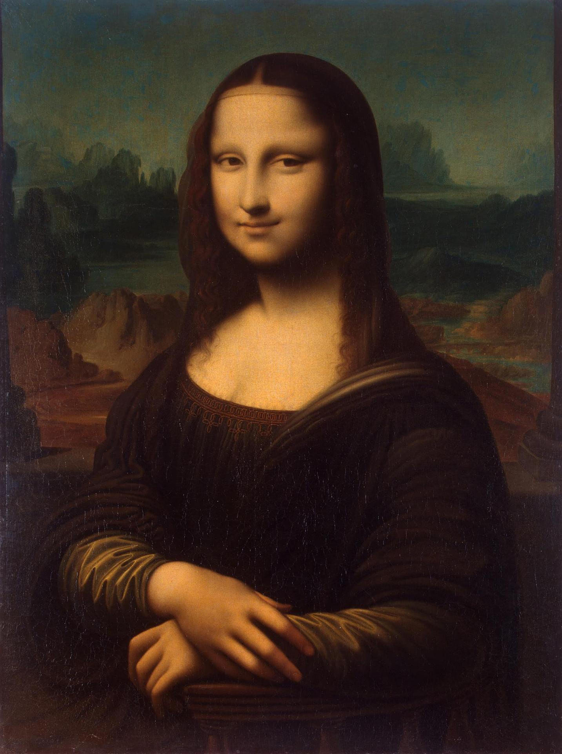
Pass by “Value”
- Thanks Mehran

Slide 93
More Examples

Slide 94
Changed Name
private void run() {
int num = 5;
cow(num);
}
private void cow(int grass) {
println(grass);
}

Slide 95
Same Variable Name
private void run() {
int num = 5;
cow();
println(num);
}
private void cow() {
int num = 10;
println(num);
}

Slide 96
Methods Called on Objects
GRect rect = new GRect(20, 20);
rect.setColor(Color.Blue);
receiver
* We will talk about how to define these later in the class

Slide 97

No Methods in Methods
private void run() {
println(“hello world”);
private void sayGoodbye() {
println(“goodbye!”);
}
}
Illegal modifier for parameter goodbye, only final is permitted
Huh?!?

Slide 98
No Methods in Methods
private void run() {
println(“hello world”);
sayGoodbye();
}
private void sayGoodbye() {
println(“goodbye!”);
}

Slide 99
Remember Booleans?

Slide 100
Boolean Variable
boolean karelIsAwesome = true;
boolean myBool = 1 < 2;

Slide 101
Boolean Operations
boolean a = true;
boolean b = false;
boolean and = a && b;
boolean or = a || b;
boolean not = !a;

Slide 102
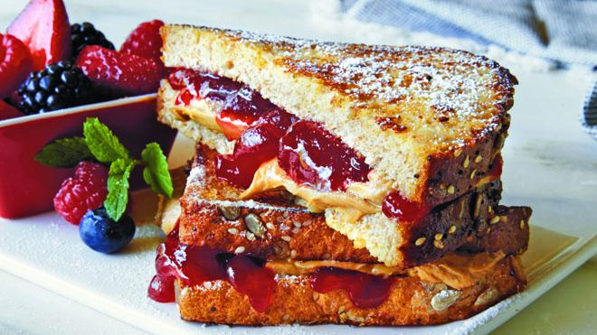

Slide 103
Is Divisible By
private void run() {
for(int i = 1; i <= 100; i++) {
if(isDivisibleBy(i, 7)) {
println(i);
}
}
}

Slide 104
Boolean Return
private void run() {
for(int i = 1; i <= 100; i++) {
if(isDivisibleBy(i, 7)) {
println(i);
}
}
}
private boolean isDivisibleBy(int a, int b) {
if((a % b) == 0) {
return true;
} else {
return false;
}
}

Slide 105
private void run() {
for(int i = 1; i <= 100; i++) {
if(isDivisibleBy(i, 7)) {
println(i);
}
}
}
private boolean isDivisibleBy(int a, int b) {
return a % b == 0;
}
Boolean Return

Slide 106
Learn How To:
Write a method that takes in input
Write a method that gives back output
Trace method calls using stacks

Slide 107

Extra Exercise
Greek mathematicians took a special interest in numbers that are equal to the sum of their proper divisors (a proper divisor of n is any divisor less than n itself). They called such numbers perfect numbers. For example, 6 is a perfect number because it is the sum of 1, 2, and 3, which are the integers less than 6 that divide evenly into 6. Similarly, 28 is a perfect number because it is the sum of 1, 2, 4, 7, and 14.
Design and implement a Java program that finds all the perfect numbers between two limits. For example, if the limits are 1 and 10000, the output should look like this:
FindPerfect
The perfect numbers between 1 and 10000 are:
6
28
496
8128

